Slide 1

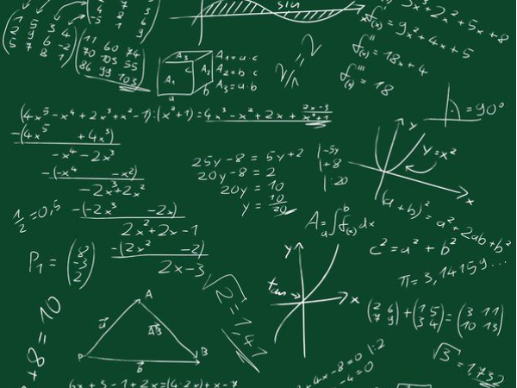
Maths at St. Nicolas

Slide 2
Aims of tonight’s meeting
To get an insight into how Maths is taught at St Nicolas
To take part in a variety of Maths activities.
To take away some ideas to support your children at home.

Slide 3

The Maths Curriculum
Children should:
Become fluent in the fundamentals of mathematics, including through varied and frequent practice with increasingly complex problems over time, so that pupils develop conceptual understanding and the ability to recall and apply knowledge rapidly and accurately.
Reason mathematically by following a line of enquiry, conjecturing relationships and generalisations and developing an argument, justification or proof using mathematical language.
Solve problems by applying their mathematics to a variety of problems with increasing sophistication, including breaking down problems into a series of simpler steps and persevering in seeking solutions.
Notes:
2015 – New Maths Curriculum – called Mastery curriculum. This means that teachers should focus on key concepts and not move on until all children have mastered that particular area. Within Maths there are three main elements that inter-weave.
Fluent –
Reasoning –
Problem solving

Slide 4
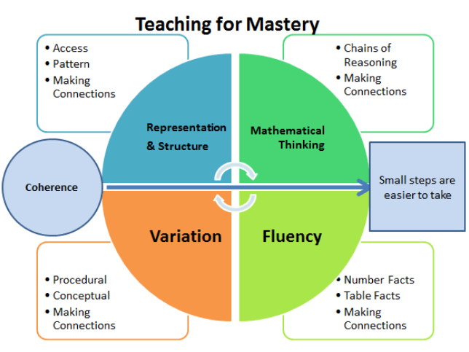

Slide 5


What is mastery?
“Mastering maths means acquiring a deep, long-term, secure and adaptable understanding of the subject” – NCETM
We achieve this by …
Carefully
sequenced,
small step
learning
Representation
that expose
mathematical
structures
Developing
mathematical
thinking
Building
fluency
Notes:
Small step learning so each child can master one idea without feeling overwhelmed. Each child building a ladder to success where they can step back when the next movement forward feels unsteady

Slide 6
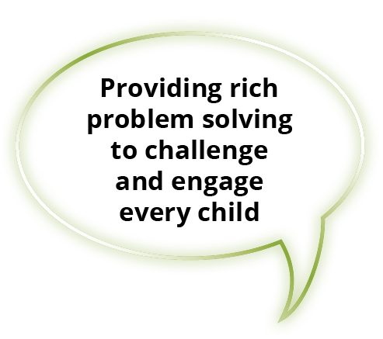
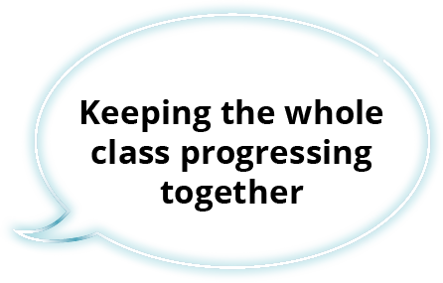

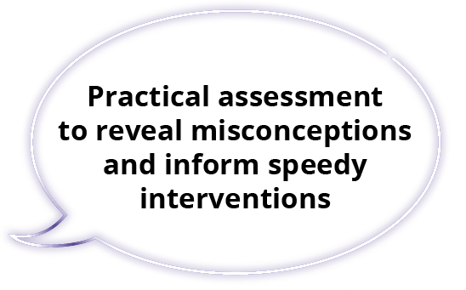
At the heart of
Power Maths is the belief that all children can achieve.
It’s built on an exciting growth mindset and problem-solving approach.
Notes:
We currently use a whole school scheme called Power Maths. Power Maths is an interactive, whole-class teaching model.
It encourages precise mathematical language and allows children to deepen their understanding as far as they can.
By working hard, all children can achieve.
Builds every concept in small, progressive steps to help keep the whole class together.
Helps children problem-solve by building on prior learning to help them see connections and patterns.
Teachers can check understanding throughout the lesson to ensure all children are keeping up.
Power Maths aims to spark curiosity and encourages rich mathematical talk.
Power Maths is aligned with the National Curriculum, and is a whole-class mastery resource to empower every child to understand and succeed in maths.

Slide 7
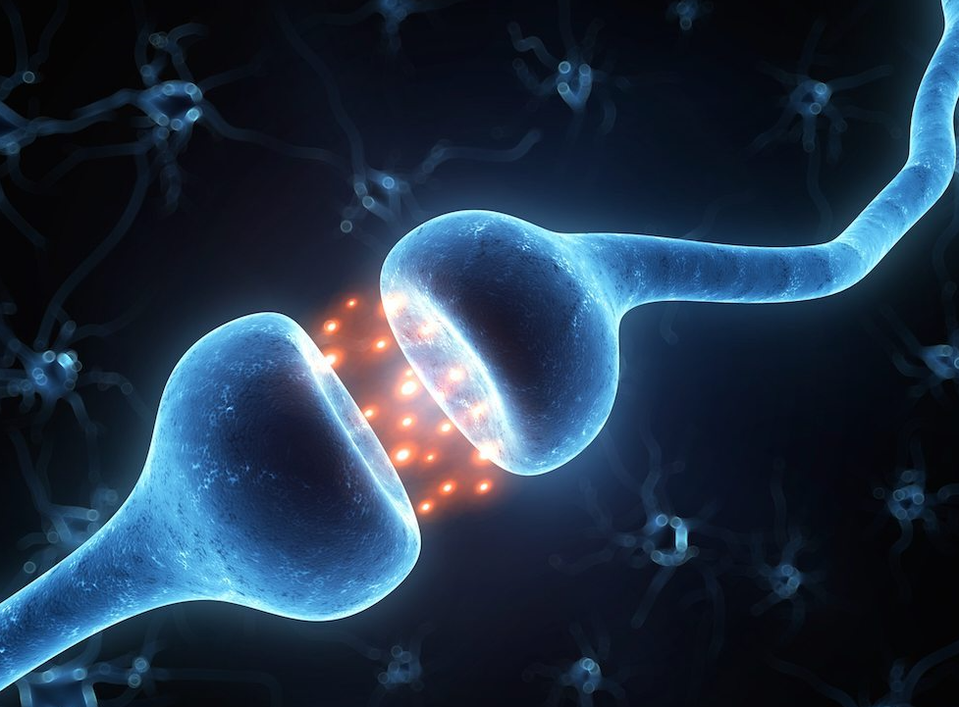
“Mistakes help me learn”
“I’m finding maths hard now, but I can improve with time and effort”
“I can improve if I keep trying”
Notes:
At St Nicolas we promote a growth mindset where mistakes are valued. Psychologist Jason Moser studied the neural mechanisms that operate in people’s brains when they make mistakes (Moser et al., 2011). Moser found when we make a mistake, synapses fire. A synapse is an electrical signal that moves between parts of the brain when learning occurs. This means the brain sparks and grows when we make a mistake, even if we are not aware of it, because it is a time of struggle; the brain is challenged and the challenge results in growth. When these mistakes occur in a mistake friendly environment students increase their level of work.

Slide 8
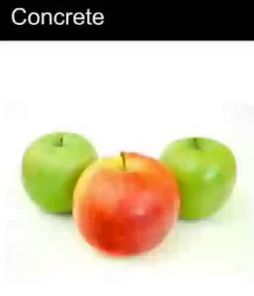
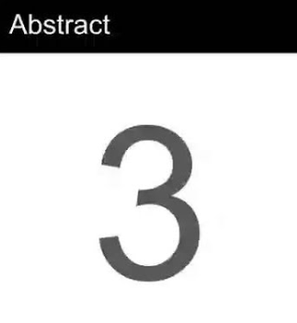
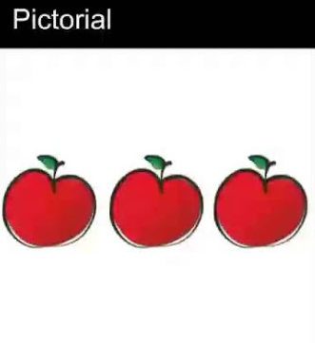
Notes:
Concrete, Pictorial, Abstract (CPA) is a highly effective approach to teaching that develops a deep and sustainable understanding of maths in pupils. Often referred to as the concrete, representational, abstract framework, CPA was developed by American psychologist Jerome Bruner. It is an essential technique within the Singapore method of teaching maths for mastery.

Slide 9
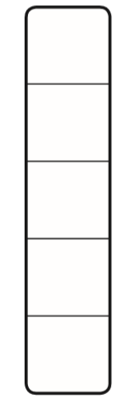
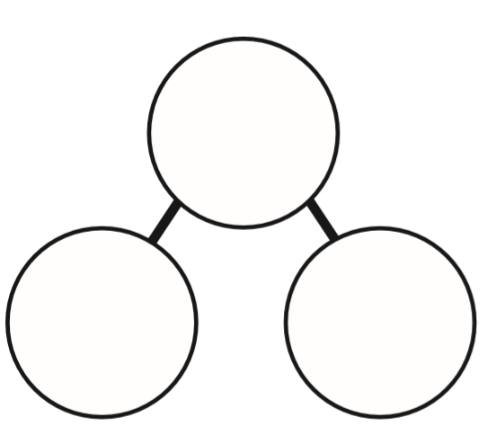
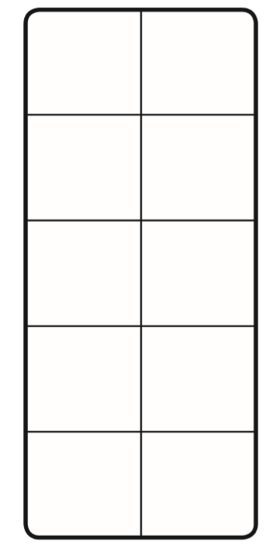
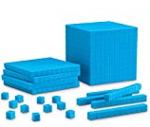
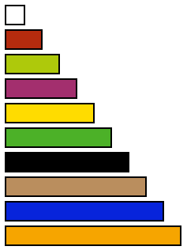
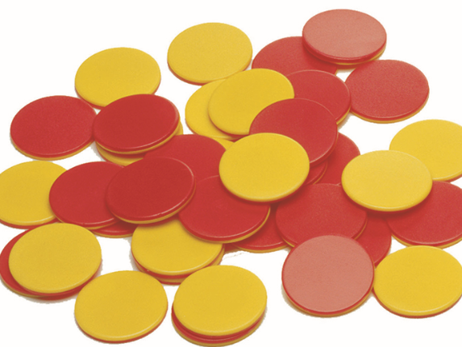
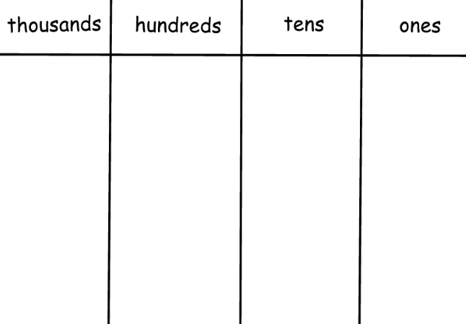
Resources to encourage thinking and mastery
Notes:
Resources used in lessons are carefully selected to match the task. The resources and the subsequent representations they create are built upon as the children move through school, ensuring that the children always have something to fall back on or develop the use of to develop their mathematical mastery. This journey starts in reception

Slide 10
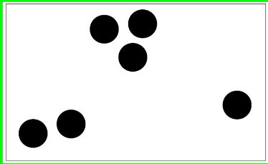
Notes:
For example: subitising- Subitising is an essential part of developing number sense in early years children by helping them to relate numbers to actual items or groups of items.

Slide 11
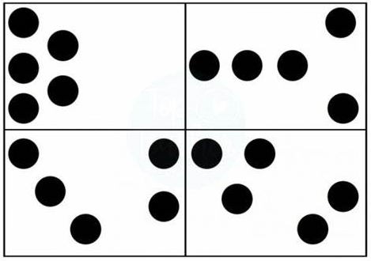
How many counters?
Notes:
Quick look at the screen, no calling out

Slide 12

How do you know?

Slide 13
How many counters?
Notes:
As adults we can do this, we have strategies but these strategies need to be nurtured. Look at the arrangement- what do we see?

Slide 14
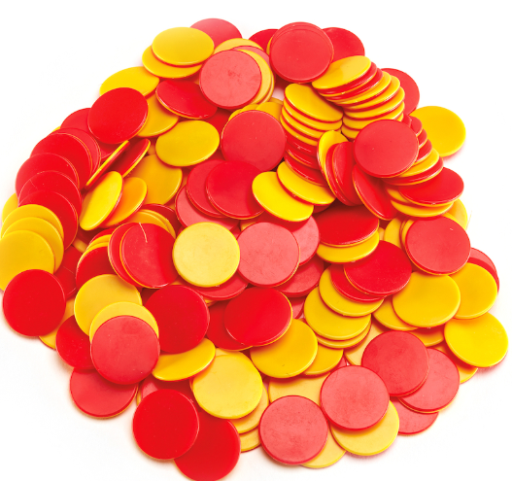
How many different ways can you make 5?

Slide 15
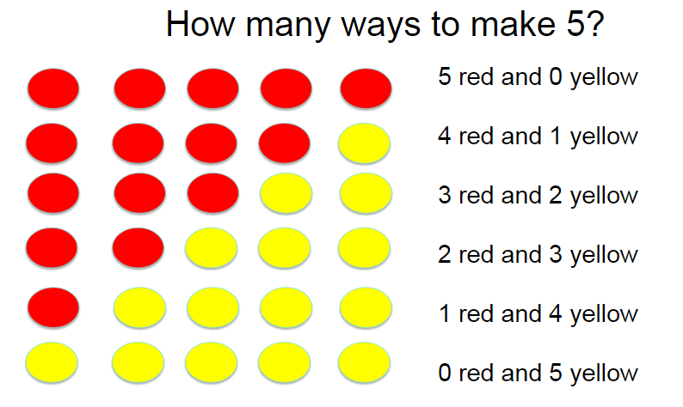
Notes:
Build children’s understanding through the use of models, creating their own representations, allowing them to develop their understanding of patterns and relationships

Slide 16
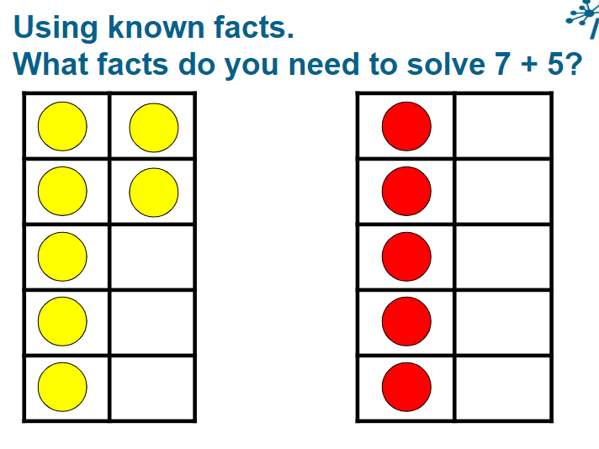
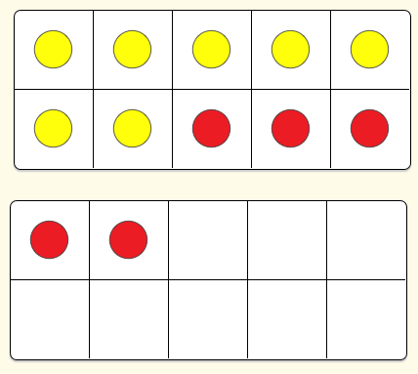
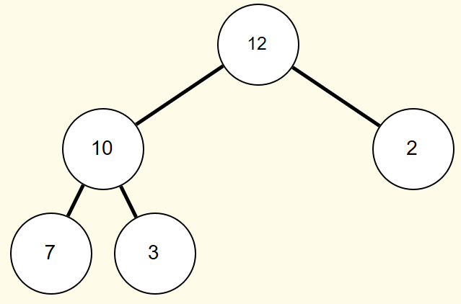
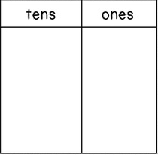

Notes:
Children are encouraged to create the representation and them complete the calculation. They are also encouraged to see (make connections) the mathematics in different ways. What did you do? In this example the prior learning allows them to build that understanding of 7 + 5 is the same as 10 + 2 and what 12 looks like.
Number Frames helps students structure numbers to 5, 10, 20, and 100. Students use the frames to count, represent, compare, and compute with numbers in a particular range.
The frames help students see quantities as equal groups of other quantities and in relation to benchmark quantities. This helps primary students move away from one-by-one counting and towards more efficient ways of counting and computing. As students advance, custom frames can be constructed to help visualize factors, products, fractional parts and more

Slide 17
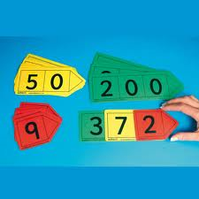
Place Value
Place value is at the heart of the number system. All digits have a value and a secure understanding of this will enable children to use and understand different calculation methods.
We constantly ask our children to tell us what each digit in a number represents.
E.g. 124 – The 1 represents 1 hundred, the 2 represents 2 tens, the 4 represents 4 ones.
Notes:
As the children move through school their developing understanding around place value allows them to explore more complex problems

Slide 18

145 + 25 =
145
+ 25
Notes:
In this example it important to reflect back on that work on subitising

Slide 19
Now it’s your turn………Using the resources, make
124 + 89

Slide 21




Notes:
With this method the children make the number (show understanding), complete the addition by regrouping the counters. The physical movement of the counters will reinforce and deepen their understanding and allows for a clear progression into the abstract formal method.

Slide 22
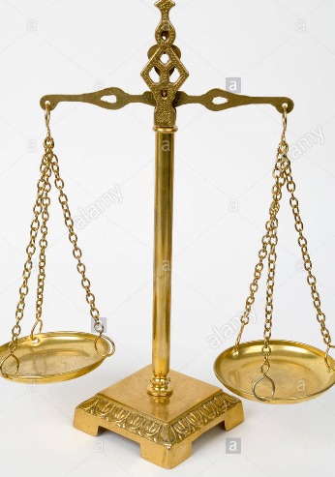
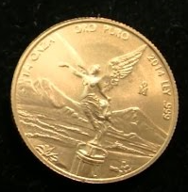
There are 8 identical coins. One of these coins is counterfeit and is known to be lighter than the genuine coins. What is the minimum number of weightings needed to identify the fake coin with a two-pan balance scale without weights?
Notes:
We use problems where we can develop reasoning and calculation skills are not holding the children back

Slide 23


Slide 24

My coat has three different buttons.
Sometimes, I do them up starting with the top button. Sometimes, I start somewhere else.
How many ways can you find to do up my coat?
How will you remember them?
Do you think there are any more? How do you know?
Notes:
We encourage children to work systematically and journal their learning

Slide 25




Slide 26
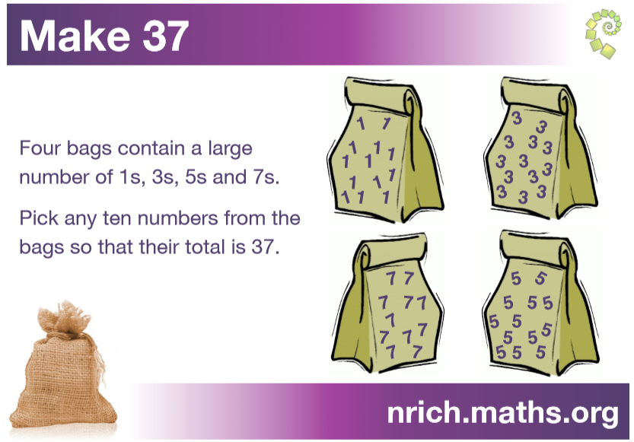

Slide 27

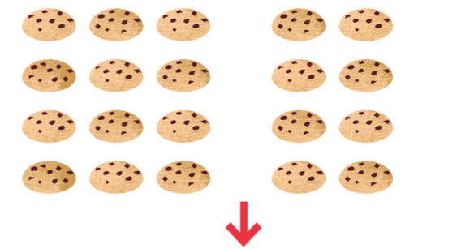
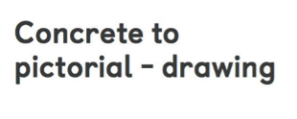
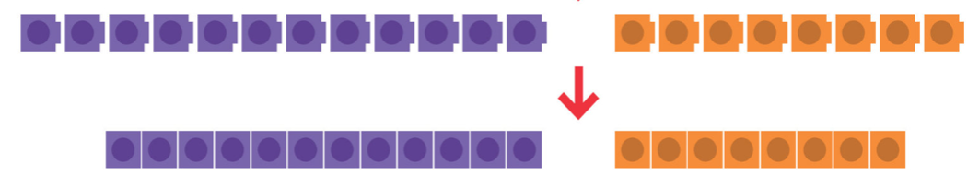


Slide 28
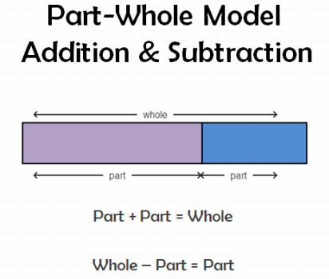
Notes:
Building on prior learning to create a bar model as a method for seeing what the problem looks like

Slide 30
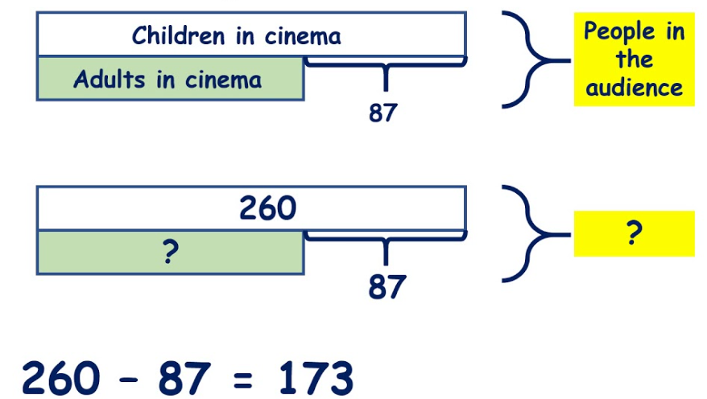

Slide 31
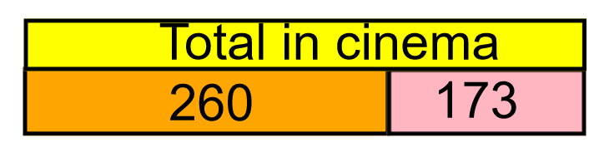

Slide 32
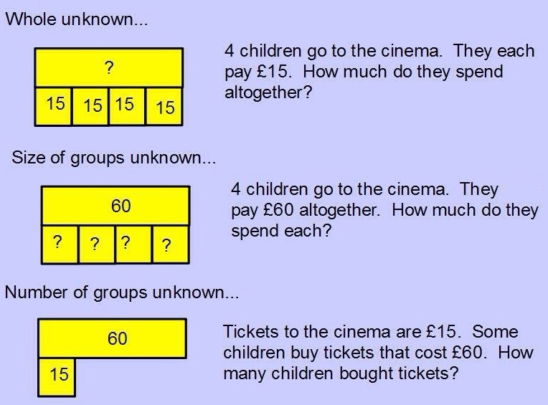
Notes:
Building on the idea of equal parts

Slide 33
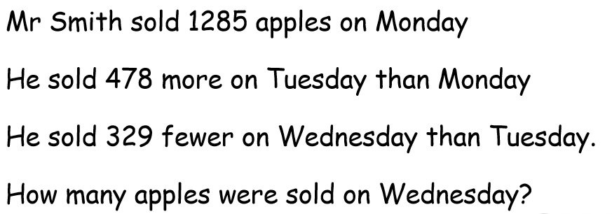
Notes:
Draw a bar model to show what this looks like

Slide 34
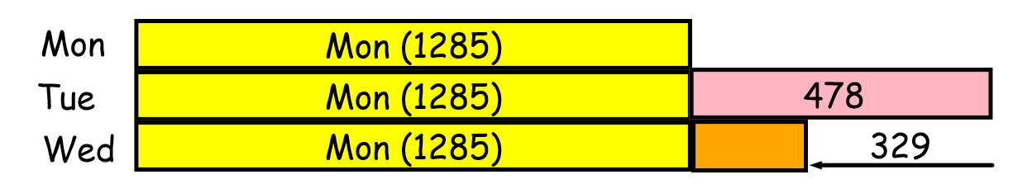
Notes:
What is the same and what is different. Too much information to hold so we need to create a representation before we can work it out

Slide 35
How could you use the bar model to create this with your child?
5776 – 855 =

Slide 36
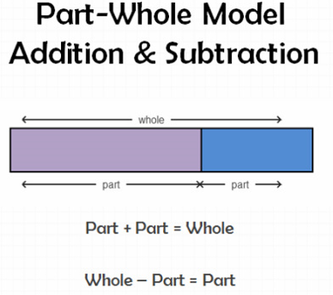
5776 – 855 =
5776
?
855

Slide 37
‘Sophie made some cakes for the school fair. She sold ³⁄₅ of them in the morning and ¹⁄₄ of what was left in the afternoon. If she sold 200 more cakes in the morning than in the afternoon, how many cakes did she make?’

Slide 38
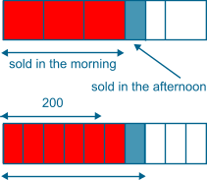
There are five more morning parts than afternoon parts, so each part is 40 (200 ÷ 5). She made 400 cakes.

Slide 39
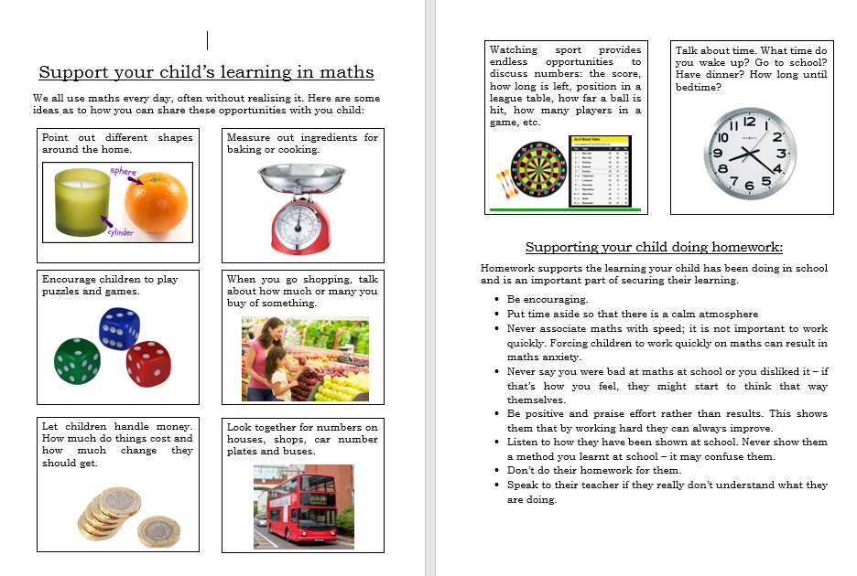
Notes:
Look for the maths in everyday experiences

Slide 40
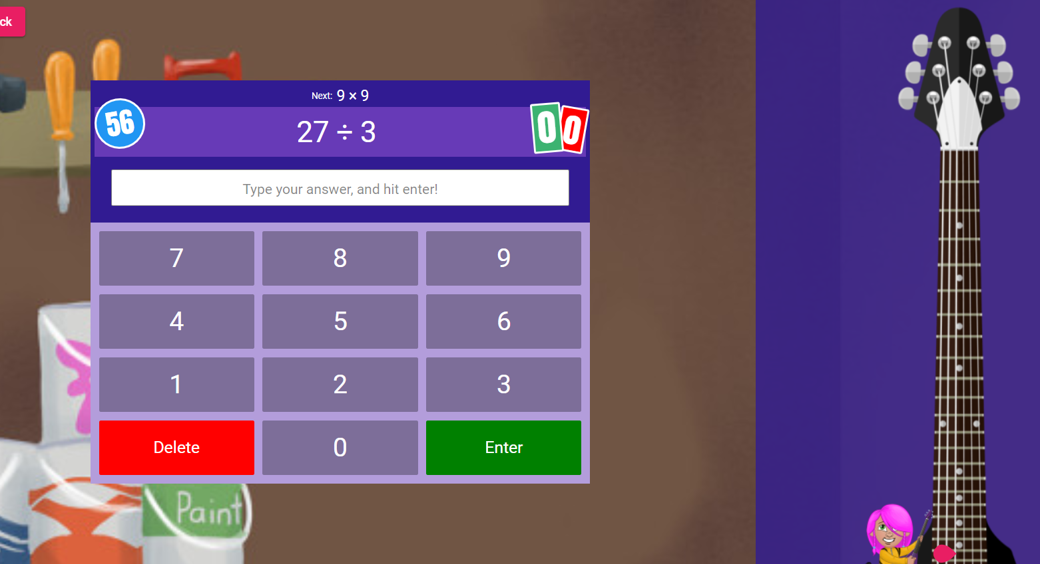
Times Tables Rock Stars
Notes:
Encourage your child to…

Slide 41
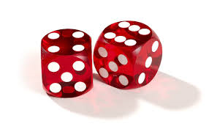
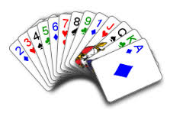
Nice or Nasty!
This game can be played in a number of ways, including with decimals. Either play it by seeing who can end up with the highest (or lowest) number. You need to decide beforehand. Using a 1-9 dice, take turns to roll it. Whatever number you land on needs to be placed on one of your squares. If you are making a 3 digit number, for example, and you are seeing who gets the highest number then you would be hoping to place any larger numbers in the hundreds column and smaller ones in the ones column, but you never know what you will roll! You can also play a version where you add numbers and decide on your target total at the start of the game.
Nice version!
Have a target total and the winner is whoever gets closest to that target without going bust.
Nasty version!
You are allowed to place digits on your partner’s board to make it trickier for them.
Notes:
Try to play some maths games

Slide 42


